Slide 1
Anthus News
A Personalised News Feed

Slide 2
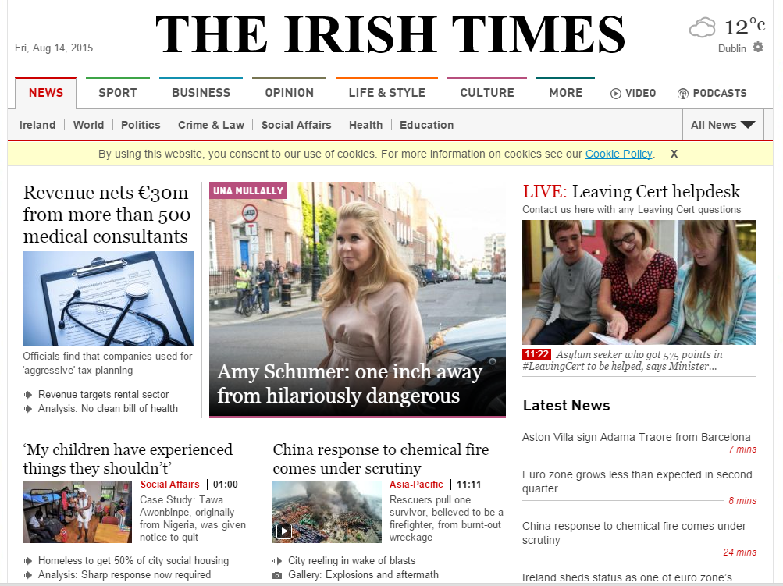
Robin:
“60% of the news on this page is not of interest to me … I want a news feed that reflects my interests …but I don’t want to have to fill in forms to tell them what I like. Make it easy to sign in and hassle-free”

Slide 3
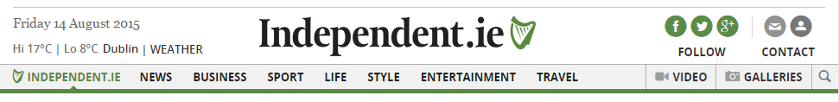
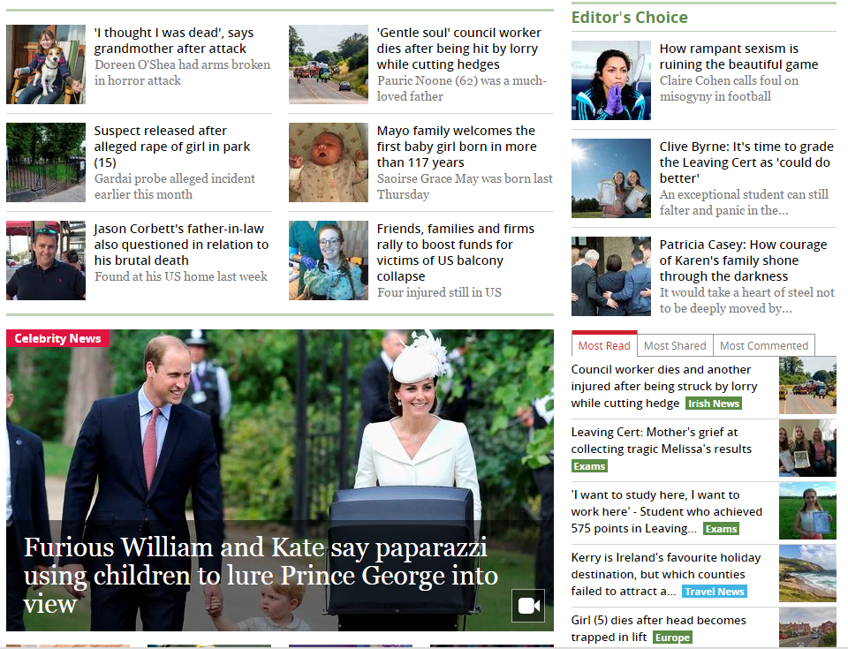

Bob Stats
“I’d like the app to show me what it thinks my interests are with some analytics.”

Slide 4

Sue Showme
“Tell me what you think my interests are, but let me change them too. I’d like the system to react to what I’m reading and give me more of the same.”

Slide 5
Personalising News
To provide a personalised news feed we need to know the user’s interests.
However:
Users generally dislike explicitly expressing their interests [1]
Studies have shown that explicit interests do not consistently match behaviour [2]
Doychev, Lawlor, et al. "An Analysis of Recommender Algorithms for Online News." CLEF, 2014.
Lavie, Talia, et al. "User attitudes towards news content personalization.“ International journal of human-computer studies 68.8 (2010): 483-495

Slide 6
Target User
Gets their news from online sources
Cares about the relevance of the news they read

Slide 7

How to present a user with news articles relevant to them without asking for their likes and dislikes?

Slide 8
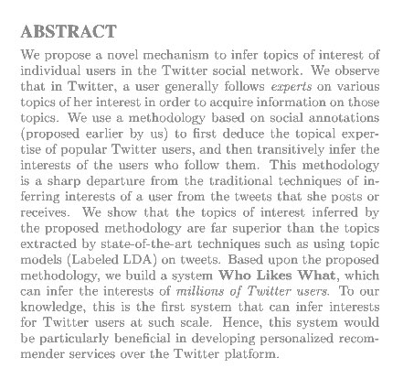
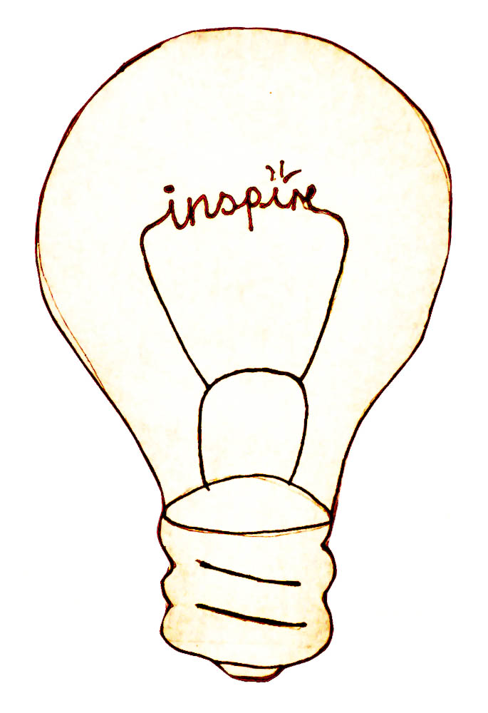
Our inspiration
We use a methodology based on social annotations to first deduce the topical expertise of popular Twitter users, and then transitively infer the interests of the users who follow them.
Bhattacharya, Parantapa/Muhammad Zafar/Niloy Ganguly/Saptarshi Ghosh/Krishna Gummadi “Inferring user interests in the Twitter social network” (2014): 357–360. doi:10.1145/2645710.2645765
Notes:
Max Planck Institute in collaboration with IT in Kharagpur, India.
This method requires the user to be an active Twitter user – that is to follow people they are interested in on Twitter.

Slide 9
DEMO
http://csi6220-2-vm4.ucd.ie

Slide 10
The System

Slide 11
Our inspiration
We use a methodology based on social annotations to first deduce the topical expertise of popular Twitter users, and then transitively infer the interests of the users who follow them.
Bhattacharya, Parantapa/Muhammad Zafar/Niloy Ganguly/Saptarshi Ghosh/Krishna Gummadi “Inferring user interests in the Twitter social network” (2014): 357–360. doi:10.1145/2645710.2645765
Notes:
This method requires the user to be an active Twitter user – that is to follow people they are interested in on Twitter
Their method is very resource intensive – they have all Twitter lists in their database and continue to load new ones as they are created.

Slide 12
Our modifications to their method
Their version | Our version
Take whole Twitter database from 2009 and add in every list added since. Use HITS algorithm to identify hubs. | Load every list on which the top 1000 Twitter users appear (120,000 lists, 9.9 million unique users ~5% of Twitter active users)
Generate 1800 inferred topics (from list data) | Select 15 topics
Identify v_{t} (>10 mentions of t on v’s lists) | Identify v as those on >10 lists and associate them with multiple t using the text from their lists (v_{t} is an array)
Consider user interested in t when they follow 3 or more v_{t} | Consider user interested in t when they follow 1or more v_{t}
t: topic v: expert v_{t} : expert in topic t

Slide 13
Technical Challenges
Characterise Articles
Infer User Interest
Recommend Articles

Slide 14

Offline: Inferring topics and experts
Parse names, descriptions of Lists
Identify top terms by frequency across all lists
Select 16 of these terms as topics
Identify experts
10 mentions of topics on a user’s Lists
Crowd-sourced topic experts
lists
Name
Description
Members
Identify topics
Topic experts
Notes:
We perform a random walk through the Twitter database to collect lists.
To date we have loaded over 700,000 members of approximately 3000 lists, this suggests an average of 250 members for each list.

Slide 15
Loading Twitter Lists
3
3
3
WFS algorithm based on top 1000 users
Load lists for Twitter users sequentially by id
3
2
2
3
2
1
2
3
2
2

Slide 16
Online: Inferring user interests
Compute Borda count of topics in a user’s friend list
Rank topics per expert by frequency
Topic 1 - 5 points
Topic 2 - 4 points etc…
Sum over entire friend list
User Account
friends
topics of interest to user
followed experts

Slide 17
Characterising news articles
Train classifier
RSS news feeds
Classify articles
TFIDF
articles topics
Notes:
Stochastic gradient descent

Slide 18
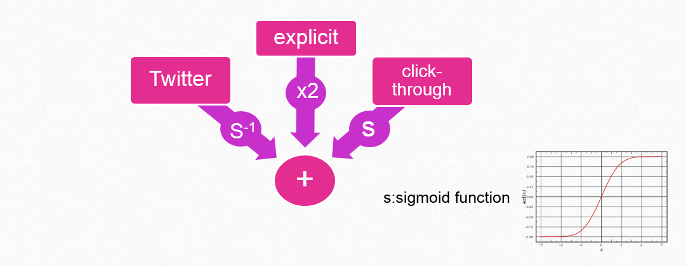
Recommend Articles: weighting function

Slide 19
System Architecture
Newspaper
Feedparser
Tweepy
Sci-kit Learn
Crowd-sourced topic experts
Inferring user
interests
Numpy
Celery
Gensim
Characterise news articles
PostgreSQL
NLTK
recommended articles
django

Slide 20
Design Objectives
Provide a personalised experience for users
Generate user interests implicitly, with minimal input from users
Make sign-up as streamlined as possible
Allow users to customise their profiles if they wish to do so
Give users feedback on the statistics we have collected

Slide 21
Design Considerations
Fast (asynchronous processing where appropriate)
Minimalistic design
Frequent trawl for new articles

Slide 22
Business Proposition

Slide 23
Customer Segments
General Users
Large news outlets
Free service
Create value by providing personalised service
Free, mutually beneficial
Generate traffic
Small News Outlets
Inclusion fees
Generate traffic, raise online profile

Slide 24
Profit Model
Sponsored articles
Pay-per-click
Inclusion fees
Annual fee
Advertising
Pay-per-click
Early Adopters - €29
General - €99
Several price points depending on traffic

Slide 25
Processes
Design & Development
Promotion & Awareness
Monetisation
Maintenance
Facebook & Twitter
Use Shopify for e-commerce

Slide 26
Review

Slide 27
Evaluation - UX
Developed a survey based on Nielsen’s usability heuristics
Invited Twitter users to use system
Beta Testers provided feedback
User interface
Bugs
Functionality
Notes:
Visibility of system.
Match between system and the real.
User control and. Consistency and. Error.
Recognition rather than Flexibility and efficiency of. Aesthetic and minimalist. Help users recognize, diagnose, and recover from. Help and documentation

Slide 28
Evaluation - Classifier
K-fold cross validation
87% accuracy
Informal evaluation by inspection
70% accuracy

Slide 29
Article Classifier: manual review
s
Art | 100% |  | Business | 40% | sport
Entertainment | 70% | sport | Celebrity | 50% | sport, tech
Music | 55% | sport | Tech | 70% | design
Education | 75% |  | Film | 70% | sport, celebrity
Science | 65% |  | Sport | 100%
Design | 40% | sport | Food | 90%
Politics | 75% |  | Travel | 50% | range of topics
Fashion | 100% |  | Health | 55% | business
70%

Slide 30


Comparison with Wholikeswhat
s
Art | theellenshow | Celebrity, entertainment | Entertainment,art, music
Food | Bourdain | Travel,food | Food,entertainment,travel
Music | Justin Bieber | music | music,art
Education | edutopia | education | tech, education
Science | natgeo | science | science, travel, tech
Design | mashable | media,tech,design | tech,design
88%

Slide 31
Problem - Tech Bias
Many users “experts” in technology
Order of list loading
Inherent to Twitter
“Hidden” feature
Solution
More lists
Sub-categories

Slide 32
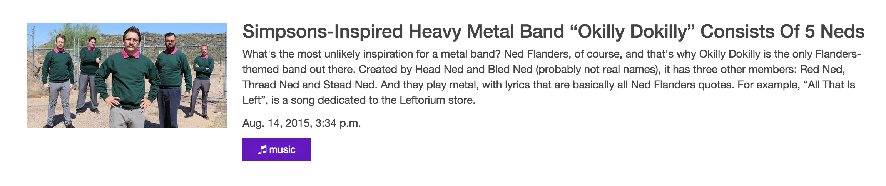
Problem - Classification Errors
Some articles well-classified

Slide 33
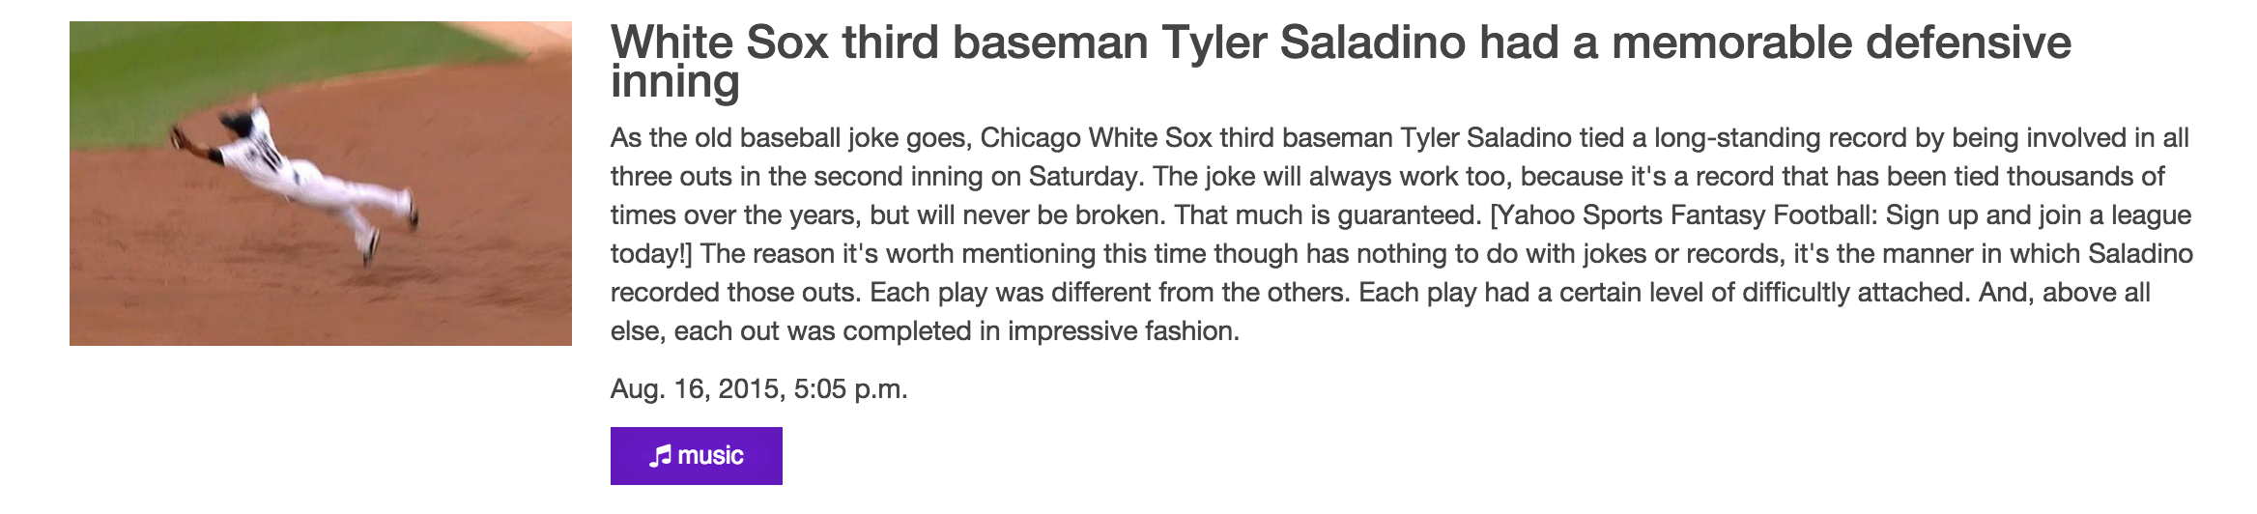
Problem - Classification Errors
Some not so well

Slide 34
Problem - Classification Errors
Small number of topics (too broad, many overlaps)
Small training set (20-30 articles per topic)
Solution
Increase training set size
More topics
Introduce topic hierarchy

Slide 35
Improvements
Improve classifier
Aggregate more List data
Recommend topics/articles to users
Recommend Twitter accounts

Slide 36
Reflections

Slide 37


Success?
Twitter Lists
Analytics
User Profiles
Implicit
Explicit
Click-throughs
Topics
Classification

Slide 38
Challenges
Getting started!
Github…
Working with limited resources
Twitter rate limits
Notes:
Get concensus on what to do

Slide 39
Lessons Learned
Skills
Python
Database
NLP
Agile methods
Research skills
Importance of communication
Coordination/delegation

Slide 40
Remember Bob and Sue?
“I’d like the app to show me what it thinks my interests are with some analytics.”
“Tell me what you think my interests are, but let me change them too. I’d like the system to react to what I’m reading and give me more of the same.”

Slide 41
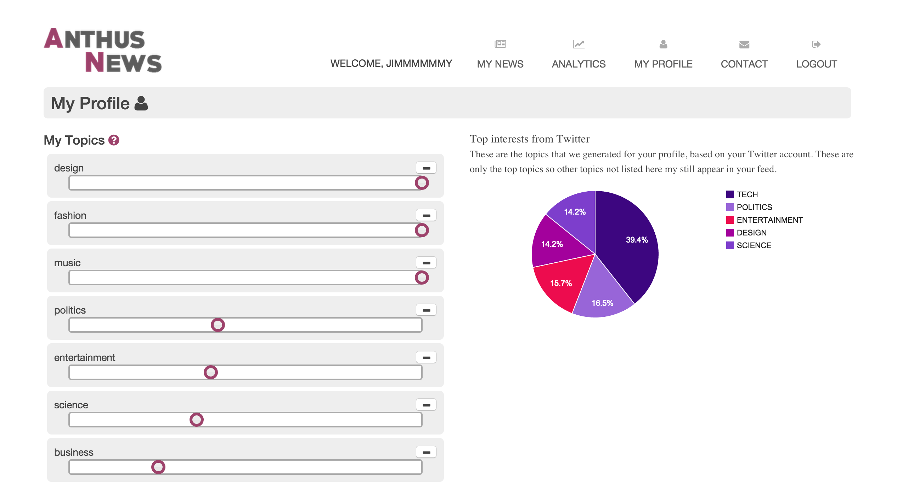


Notes:
The system identifies Katy Perry as an expert in the topics of music, entertainment, art and celebrity.

Slide 42
Questions?

